Slide 1


DATA ANALYST PORTFOLIO PROJECT
BANK LOAN ANALYSIS
PART 1
MS SQL SERVER

Slide 2
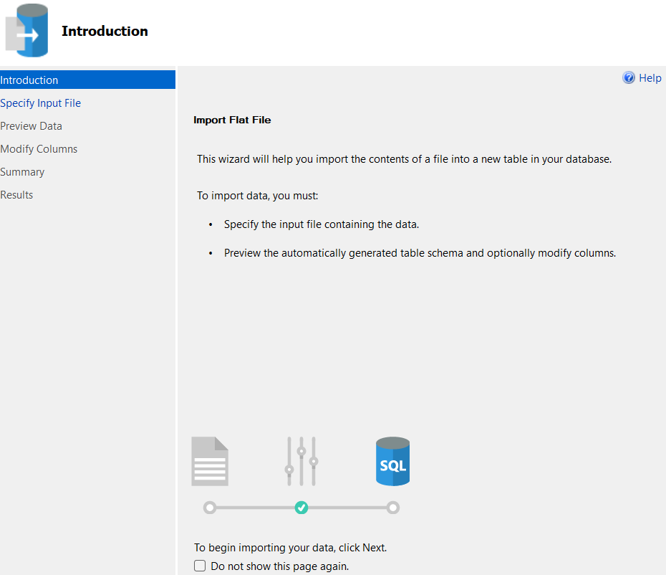

MS SQL SERVER
IMPORT
DATA

Slide 3

MS SQL SERVER
CREATING
DB

Slide 4
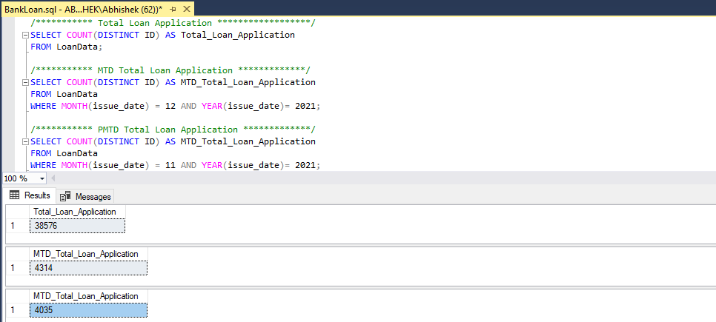
MS SQL SERVER
WRITING
QUERIES

Slide 5
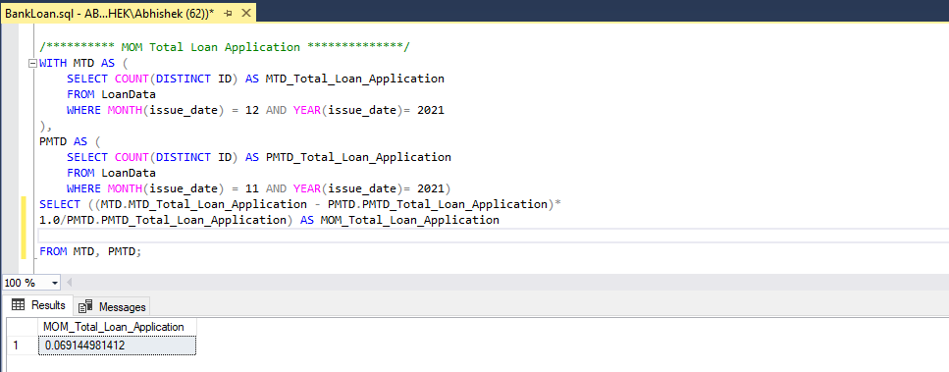
MS SQL SERVER
WRITING
QUERIES

Slide 6
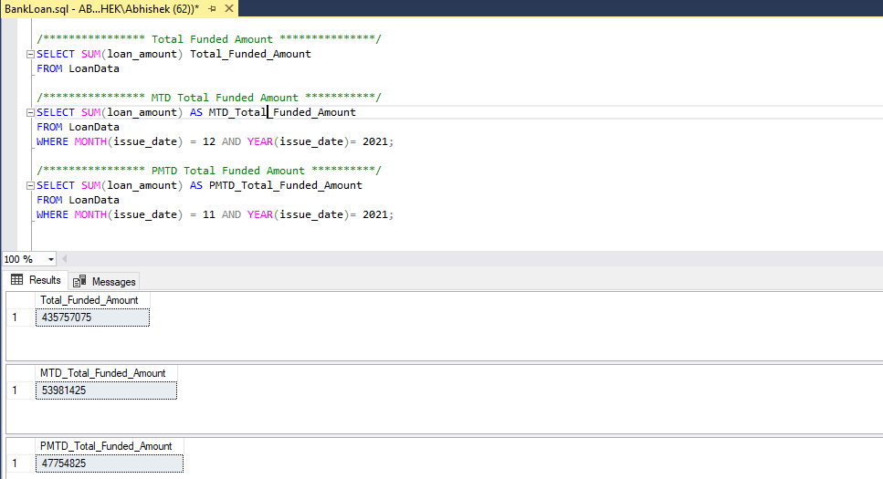
MS SQL SERVER
WRITING
QUERIES

Slide 7
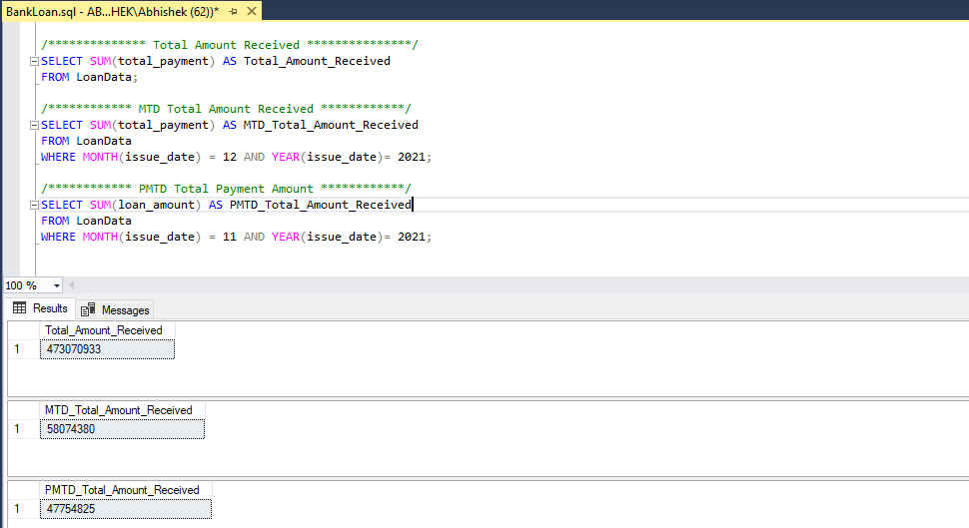
MS SQL SERVER
WRITING
QUERIES

Slide 8
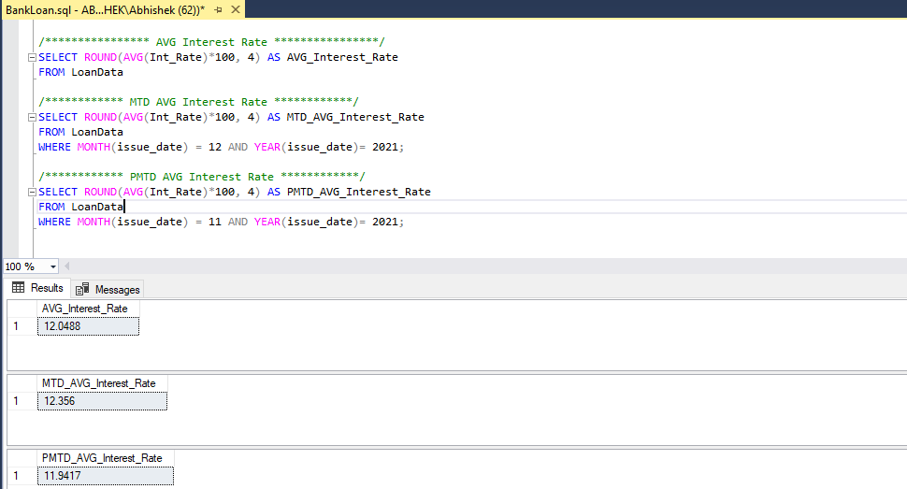
MS SQL SERVER
WRITING
QUERIES

Slide 9
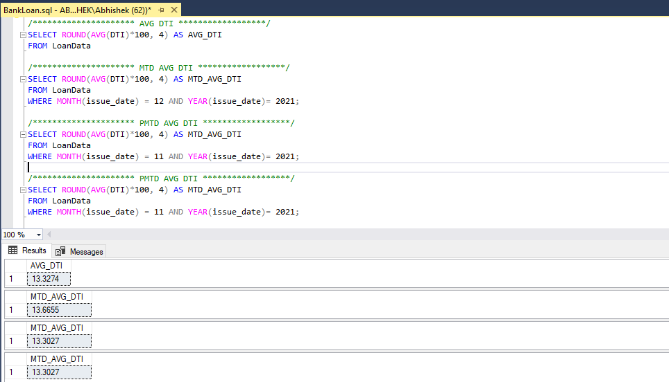
MS SQL SERVER
WRITING
QUERIES

Slide 10
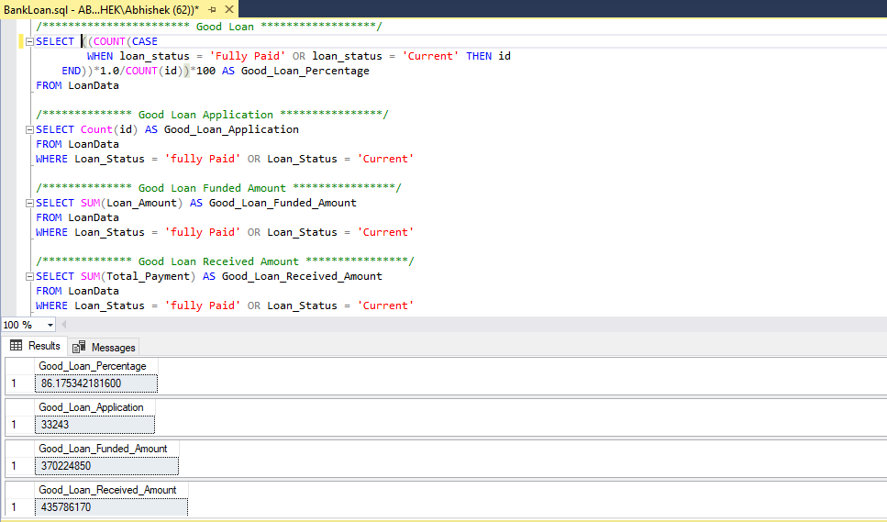
MS SQL SERVER
WRITING
QUERIES

Slide 11
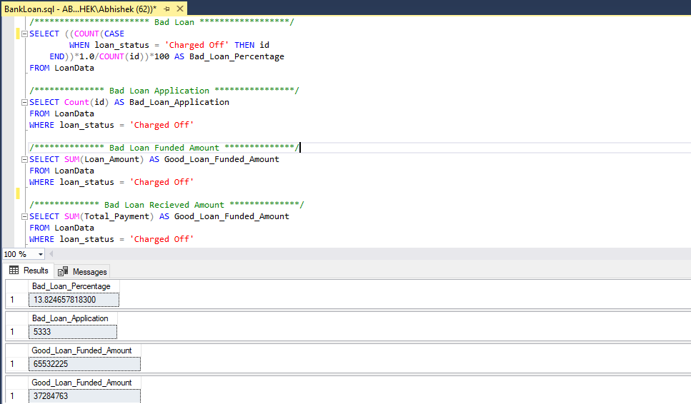
MS SQL SERVER
WRITING
QUERIES

Slide 12

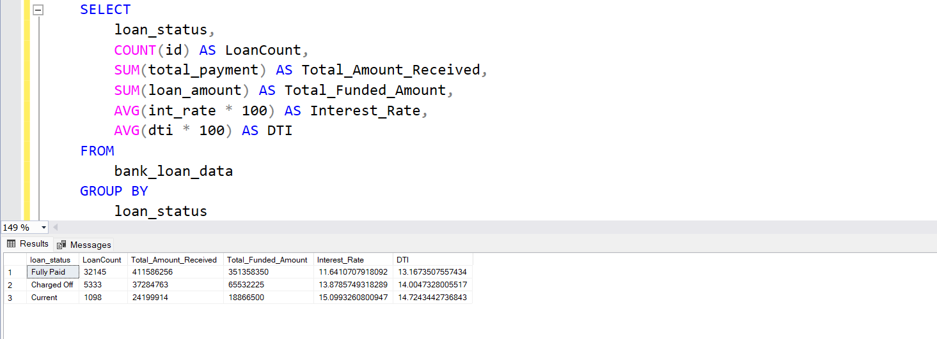
FOR ALL QUERIES PLEASE CHECK GITHUB REPOSITORY
WHERE I HAVE SOLVE ALL THE BUSINESS PROBLEMS
WITH SQL
TO COMPARING RESULTS WITH POWER BI

Slide 13

DATA ANALYST PORTFOLIO PROJECT
BANK LOAN ANALYSIS
PART 2
POWER BI

Slide 14


POWER BI
CONNECTING TO
MS SQL SERVER

Slide 15
1 PROJECT OVERVIEW
This project involved developing an interactive, visually appealing and fully dynamic dashboard using data analysis and visualisation tools PowerBI, MSSQL and EXCEL. The analysis was conducted on a dataset containing various loan-related details, enabling the extraction of valuable insights across three main dashboards.

Slide 16
PROBLEM STATEMENT
DASHBOARD 1: SUMMARY
Key Performance Indicators (KPIs) Requirements:
Total Loan Applications: We need to calculate the total number of loan applications received during a specified period. Additionally, it is essential to monitor the Month-to-Date (MTD) Loan Applications and track changes Month-over-Month (MoM).
Total Funded Amount: Understanding the total amount of funds disbursed as loans is crucial. We also want to keep an eye on the MTD Total Funded Amount and analyse the Month-over-Month (MoM) changes in this metric.
Total Amount Received: Tracking the total amount received from borrowers is essential for assessing the bank's cash flow and loan repayment. We should analyse the Month-to-Date (MTD) Total Amount Received and observe the Month-over-Month (MoM) changes.
Average Interest Rate: Calculating the average interest rate across all loans, MTD, and monitoring the Month-over-Month (MoM) variations in interest rates will provide insights into our lending portfolio's overall cost.
Average Debt-to-Income Ratio (DTI): Evaluating the average DTI for our borrowers helps us gauge their financial health. We need to compute the average DTI for all loans, MTD, and track Month-over-Month (MoM) fluctuations.

Slide 17
PROBLEM STATEMENT
DASHBOARD 1: SUMMARY
Good Loan v Bad Loan KPI’s
Good Loan:
Good Loan Application Percentage
Good Loan Applications
Good Loan Funded Amount
Good Loan Total Received Amount
Bad Loan
Bad Loan Application Percentage
Bad Loan Applications
Bad Loan Funded Amount
Bad Loan Total Received Amount
Loan Status Grid View
In order to gain a comprehensive overview of our lending operations and monitor the performance of loans, we aim to create a grid view report categorized by 'Loan Status.’ By providing insights into metrics such as 'Total Loan Applications,' 'Total Funded Amount,' 'Total Amount Received,' 'Month-to-Date (MTD) Funded Amount,' 'MTD Amount Received,' 'Average Interest Rate,' and 'Average Debt-to-Income Ratio (DTI),' this grid view will empower us to make data-driven decisions and assess the health of our loan portfolio.

Slide 18
PROBLEM STATEMENT
DASHBOARD 2: OVERVIEW
CHARTS
Monthly Trends by Issue Date (Line Chart): To identify seasonality and long-term trends in lending activities
Regional Analysis by State (Filled Map): To identify regions with significant lending activity and assess regional disparities
Loan Term Analysis (Donut Chart): To allow the client to understand the distribution of loans across various term lengths.
Employee Length Analysis (Bar Chart): How lending metrics are distributed among borrowers with different employment lengths, helping us assess the impact of employment history on loan applications.
Loan Purpose Breakdown (Bar Chart): Will provide a visual breakdown of loan metrics based on the stated purposes of loans, aiding in the understanding of the primary reasons borrowers seek financing.
Home Ownership Analysis (Tree Map): For a hierarchical view of how home ownership impacts loan applications and disbursements.
Metrics to be shown: 'Total Loan Applications,' 'Total Funded Amount,' and 'Total Amount Received'

Slide 19
PROBLEM STATEMENT
DASHBOARD 3: DETAILS
GRID
Need for a comprehensive 'Details Dashboard' that provides a consolidated view of all the essential information within our loan data. This Details Dashboard aims to offer a holistic snapshot of key loan-related metrics and data points, enabling users to access critical information efficiently.
Objective:
The primary objective of the Details Dashboard is to provide a comprehensive and user-friendly interface for accessing vital loan data. It will serve as a one-stop solution for users seeking detailed insights into our loan portfolio, borrower profiles, and loan performance.

Slide 20
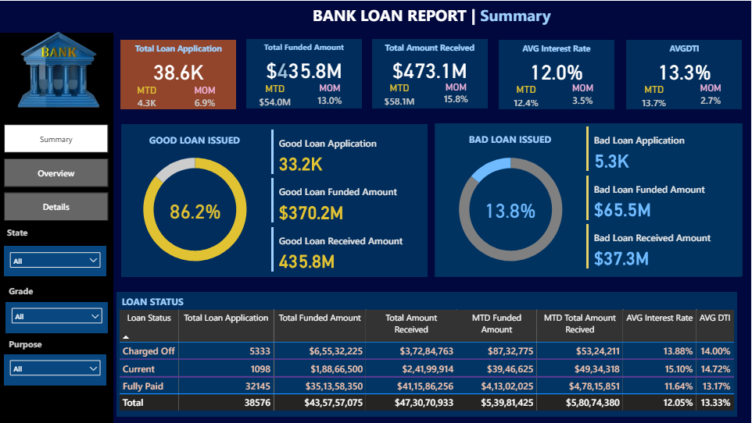
POWER BI

Slide 21
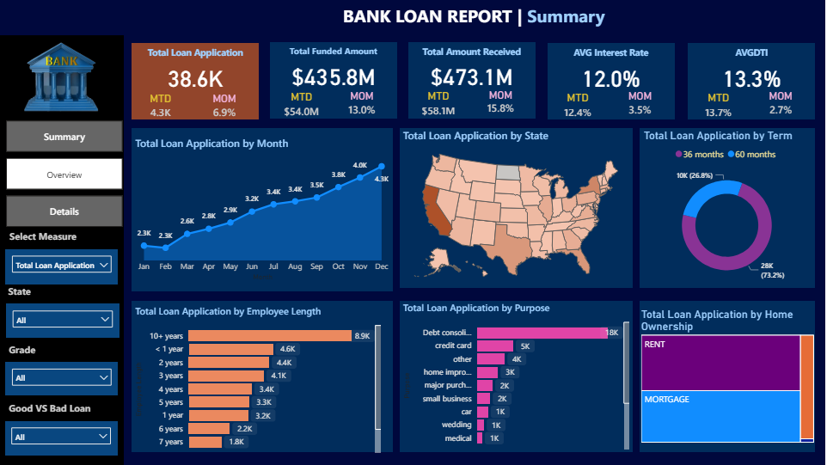
POWER BI

Slide 22
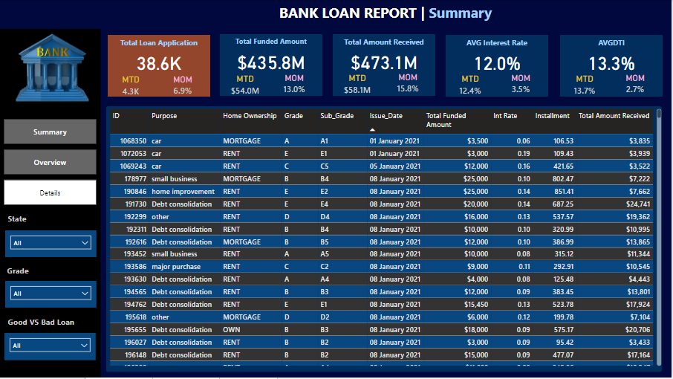
POWER BI

Slide 23
KEY INSIGHTS
FROM DASHBOARD 1
: SUMMARY
● Loan Applications: There were 38.6K total loan applications, showing a Month-over-Month (MoM) increase of 6.9%.
● Funded Amount and Amount Received: The total funded amount is $435.8M, with a MoM increase of 13%. The total amount received is $473.1M, with a MoM increase of 15.8%.
● Interest Rate and DTI: The average interest rate is 12.0%, with a slight MoM increase of 3.5%. The average Debt-to-Income Ratio (DTI) is 13.3%, with a 2.7% MoM increase.
● Good vs. Bad Loans: 86.2% of loans issued are considered good, totaling $370.2M in funded amounts, while 13.8% are bad loans, totaling $65.5M in funded amounts.
● Loan Status: The grid shows a detailed breakdown of loan status categories, such as charged off, current, and fully paid, along with their respective metrics.

Slide 24
: OVERVIEW
● Monthly Trends: There is a noticeable upward trend in loan applications, with a peak in December.
● Regional Analysis: Certain states show higher loan application volumes, indicating regional demand variations.
● Loan Term Distribution: A majority of the loans (73.2%) are for 60 months, while 26.8% are for 36 months.
● Employee Length Analysis: Applicants with 10+ years of employment history form the largest group, followed by those with less than one year.
● Loan Purpose: Debt consolidation is the most common purpose for loans, followed by credit card refinancing and home improvement.
● Home Ownership: Mortgage holders constitute a significant portion of the loan applicants compared to renters.
FROM DASHBOARD 2

Slide 25
FROM DASHBOARD 3
: DETAILS
● Detailed View: The detailed grid provides comprehensive data on individual loans, including purpose, home ownership status, grade, sub-grade, issue date, funded amount, interest rate, installment, and total amount received.

Slide 26
Recommendations
DASHBOARD 1:SUMMARY
● Improve Loan Application Processes: Considering the increase in loan applications, streamline the application process using automated systems to handle the growing volume efficiently.
● Interest Rate Strategy: Evaluate and potentially adjust interest rate strategies to remain competitive while managing risk effectively, considering the slight increase in average interest rates.
● Debt-to-Income Ratio Monitoring: Monitor the DTI closely to manage borrower risk and adjust lending criteria as necessary to maintain a healthy loan portfolio.

Slide 27
FROM DASHBOARD 2: OVERVIEW
● Regional Marketing Efforts: Focus marketing efforts on states with higher loan application volumes to capitalize on regional demand. Investigate and address factors contributing to lower performance in other regions.
● Loan Product Customization: Customize loan products based on the identified preferences for loan terms and purposes. For example, develop targeted products for debt consolidation and home improvement loans.
● Employment-Based Risk Assessment: Given the high number of applications from individuals with over ten years of employment, consider tailoring risk assessment models to leverage employment stability as a risk indicator.

Slide 28
FROM DASHBOARD 3: DETAILS
● Borrower Education Programs: Develop educational programs to improve financial literacy among borrowers, helping them make informed decisions and potentially reducing delinquency rates.
● Risk-Based Pricing Strategies: Implement risk-based pricing strategies to offer competitive rates to low-risk borrowers while adequately pricing higher-risk loans to cover potential losses.
● Detailed Monitoring and Analysis: Use the detailed data to continuously monitor loan performance and borrower behavior, allowing for proactive adjustments in lending policies and practices.

Slide 29
FUNCTIONALITIES USED
SQL – MS SQL SERVER
POWER BI
Creating Database
Creating Table
Select
Datename
Datepart
Cast
Decimal
Month
Hour
Quarter
Day
Group by
Order by
Decimal
Limit
Count
Distinct
CTE
Partition
Connecting to SQL Server
Data Cleaning
Data Modelling
Data Processing
Power Query
Date Tables
Time Intelligence Func
DAX
Date Function
Text Function
Filter Function
Calculate
SUM/ SUMX
Creating KPI’s
New Card Visual
Creating Charts
Formatting visuals
Creating Functions
Navigations

Slide 30
SOFTWARE USED
MS OFFICE/ EXCEL: VERSION 2021
MS SQL SERVER: 19.0
SQL SERVER MANAGEMENT STUDIO – 19.0.20209.0
POWER BI: JUNE 2023 Version

Slide 31
Thanks For Reading

